Slide 1
Data science final project
Doron Kreiz
Hen Ezequel

Slide 2
Main question
Can we predict rating of a movie by the year he was published and by his gener?

Slide 3
Background

Slide 4
Movies is a significant part of our lives since the late 19th century.
the popularity and the type of movies effected by the time he was published-movies who was popular in the 40th probably wont be popular if they were published now and the opposite.

Slide 5
Why Movies ranking?
People love to rank stuff including movies.
People would like to know what was his popularity, gross, rate by critics.
So the are many websites who rank movies by those characteristics and more.
We decided to investigate the top 100 movies by popularity in website called IMDB

Slide 6
What data we need?

Slide 7
Movies characteristics
Title-the movie’s title
gener-the movie’s gener
year-the year he was published
Duration-the duration of the movie
rating-people’s votes on IMDB
Director-the movie’s director
Stars-the stars of thr movie
Votes-amount of people who votes to the movie at imdb
Gross-the movie profits

Slide 8
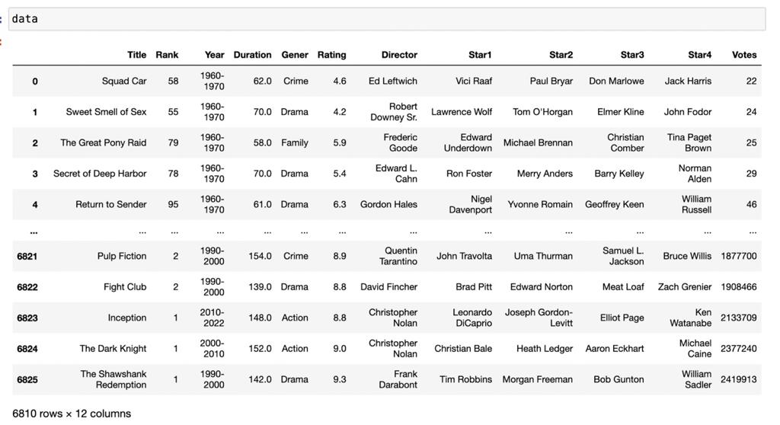
Our data set

Slide 9
Our data sources

Slide 10
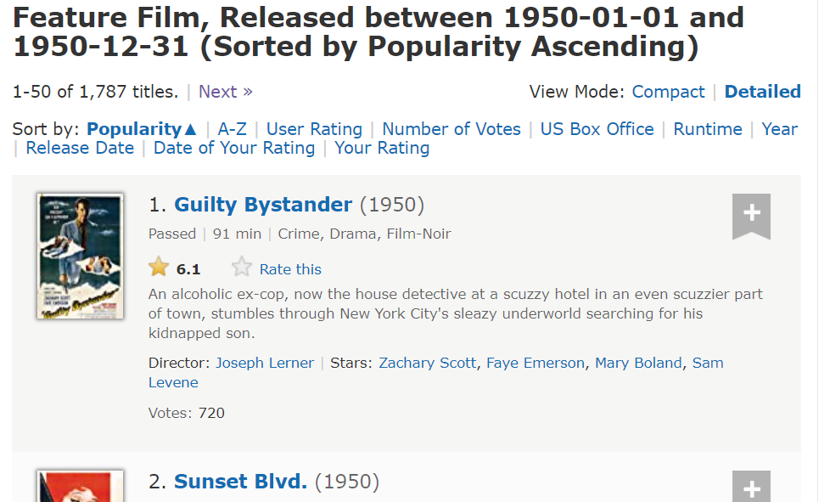
The website
We scraped data from IMDB:
Website that has a lot of information about movies and we can take from him lots of statistics and tables

Slide 11
Tools we used

Slide 12



Scraping tools
We used Selenium and Java script commands in addition to Python
The only API we found

Slide 13
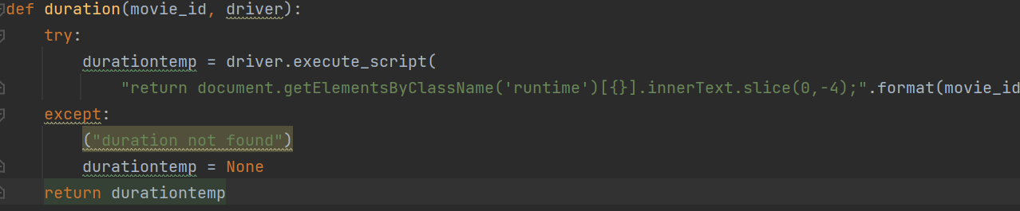
Scraping tool implemented in python
An example of selenium usage
An example of java script usage

Slide 14
Data cleaning

Slide 15
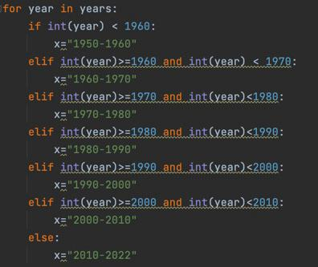
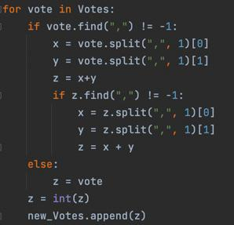
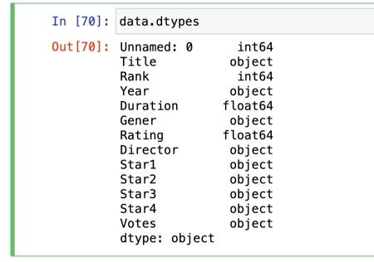
Missing data and rearranging
We have got lots of information we decided to clean all the values that had None and we have created a new column with converted years from int to object in order we will be able to display the years as decades on the graphs.
Also we have fixed the vote columns –we deleted all the “,” in order to convert it to numeric

Slide 16
EDA

Slide 17
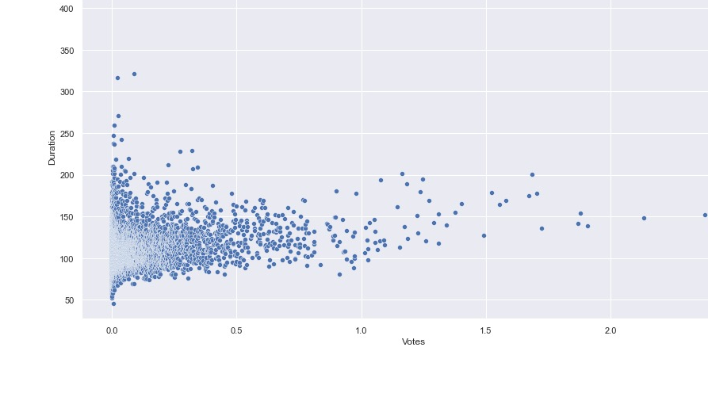
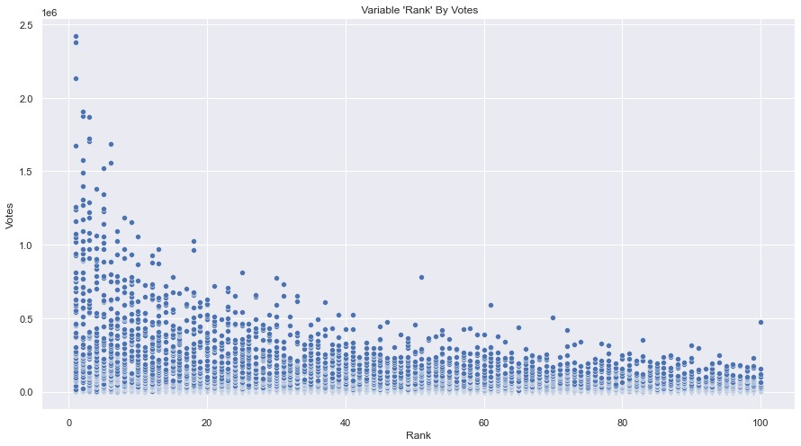
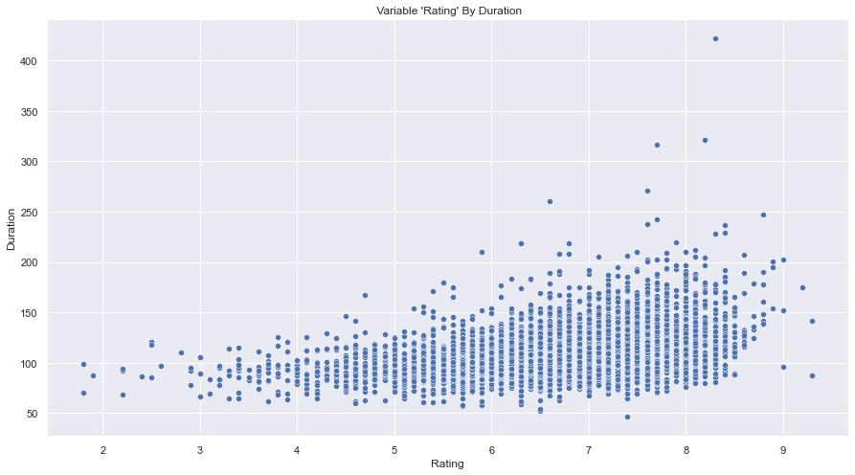
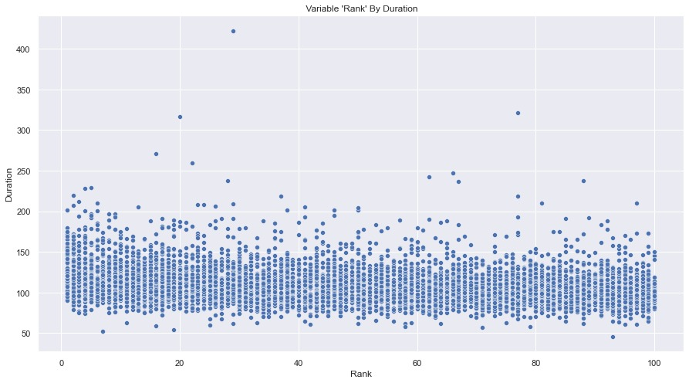
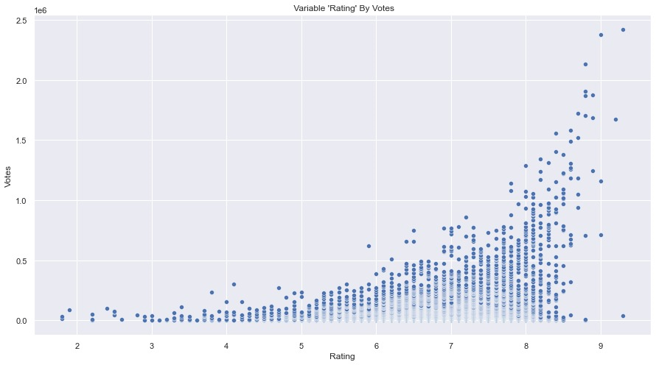
Scatter plot
Scatter plot gives us the ability to build graphs that represent numeric data by numeric data
Conclusion: the more the movie is short the more people voting for him
Conclusion: the most the raiting high the most people vote
Conclusion: the most the duration is long the most the rating is high
Conclusion: the duration doesn’t effect rank
Conclusion: the low the rank is the most people vote

Slide 18
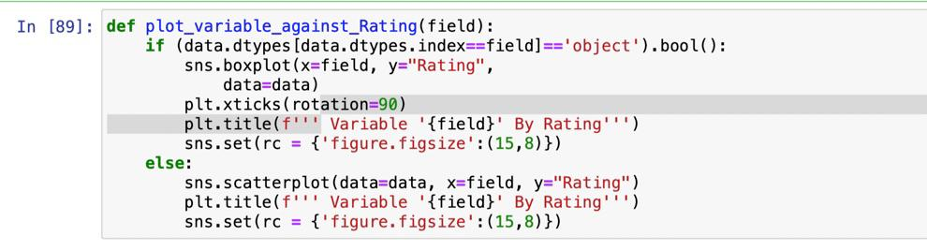
Scatter plot
Scatter plot code example:
Countries with the highest players ratings
Countries with the highest players value
From which countries most wonder kids come from

Slide 19
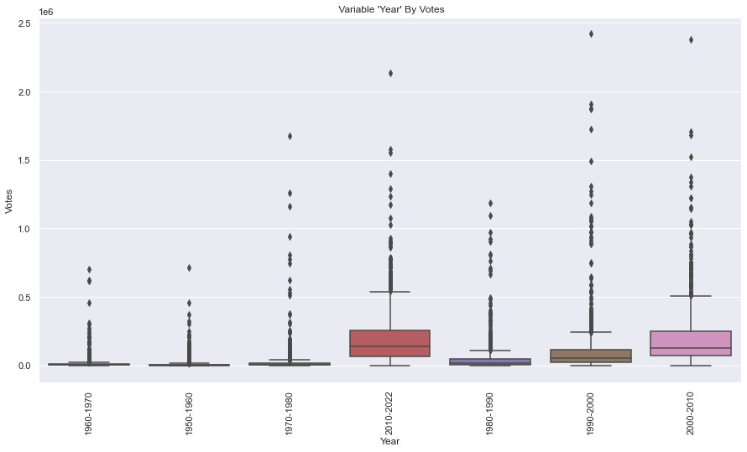
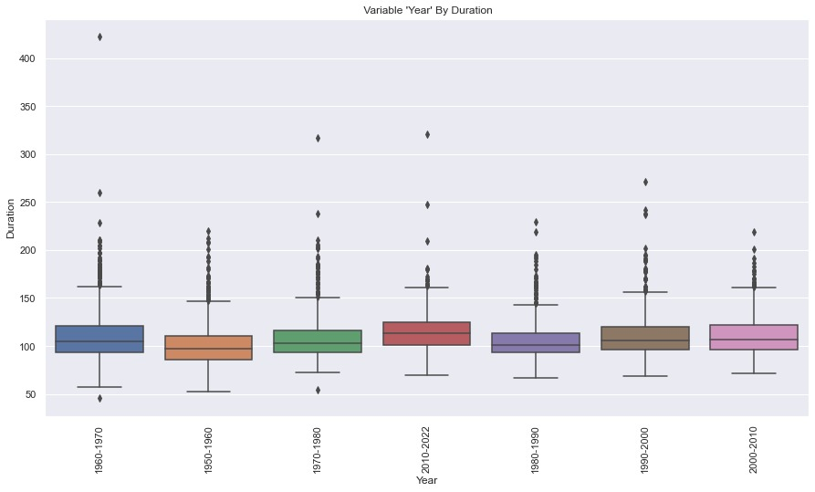
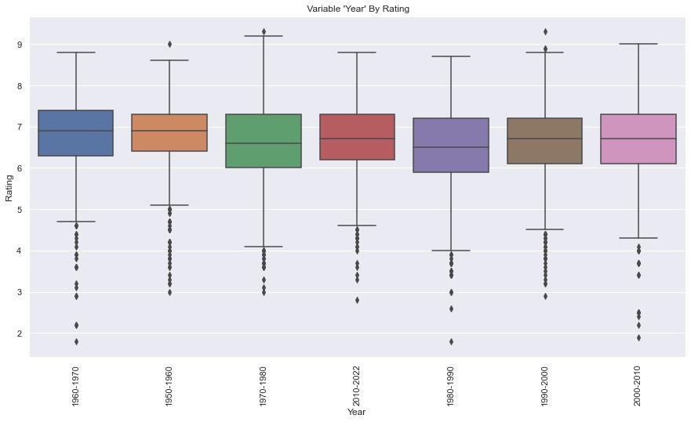
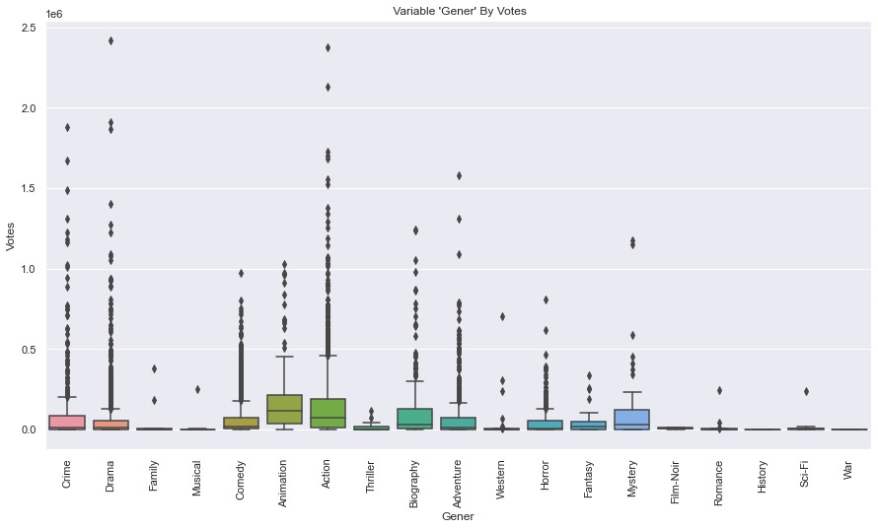
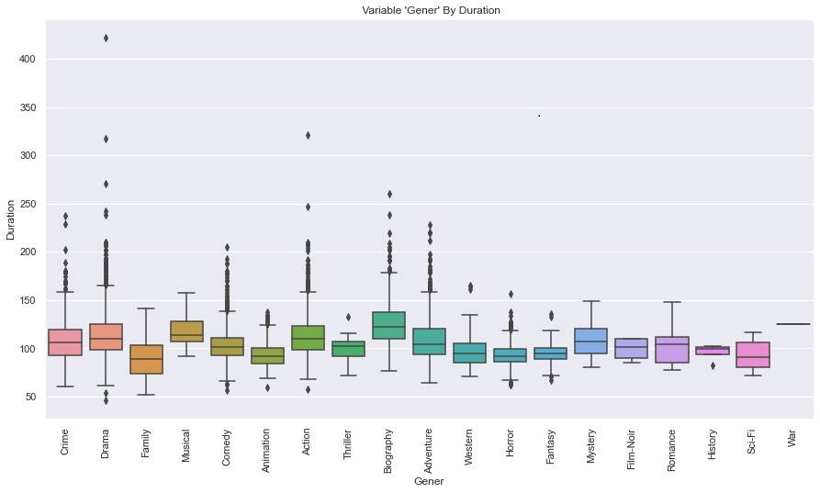
Box plot
Box plot gives us the ability to build graphs that represent numeric data by objective data
Conclusion: Biography movies are the longest movies
Conclusion: Vintage movies are most popular(50th 60th)
Conclusion:The longest movies was between the years 2010-2022
Conclusion:people find action gener most interesting to vote
Conclusion: People voted the most on movies between the year 2010-2022

Slide 20
Box plot
Box plot code example:
Countries with the highest players ratings
Countries with the highest players value
From which countries most wonder kids come from

Slide 21
Machine learning

Slide 22
logistic regression
A reminder, our question is we can predict rating of a movie by his characteristics.
For us, a successfully prediction is if the rating is above 6.7.
In order to answer this question we used logistic regression.

Slide 23
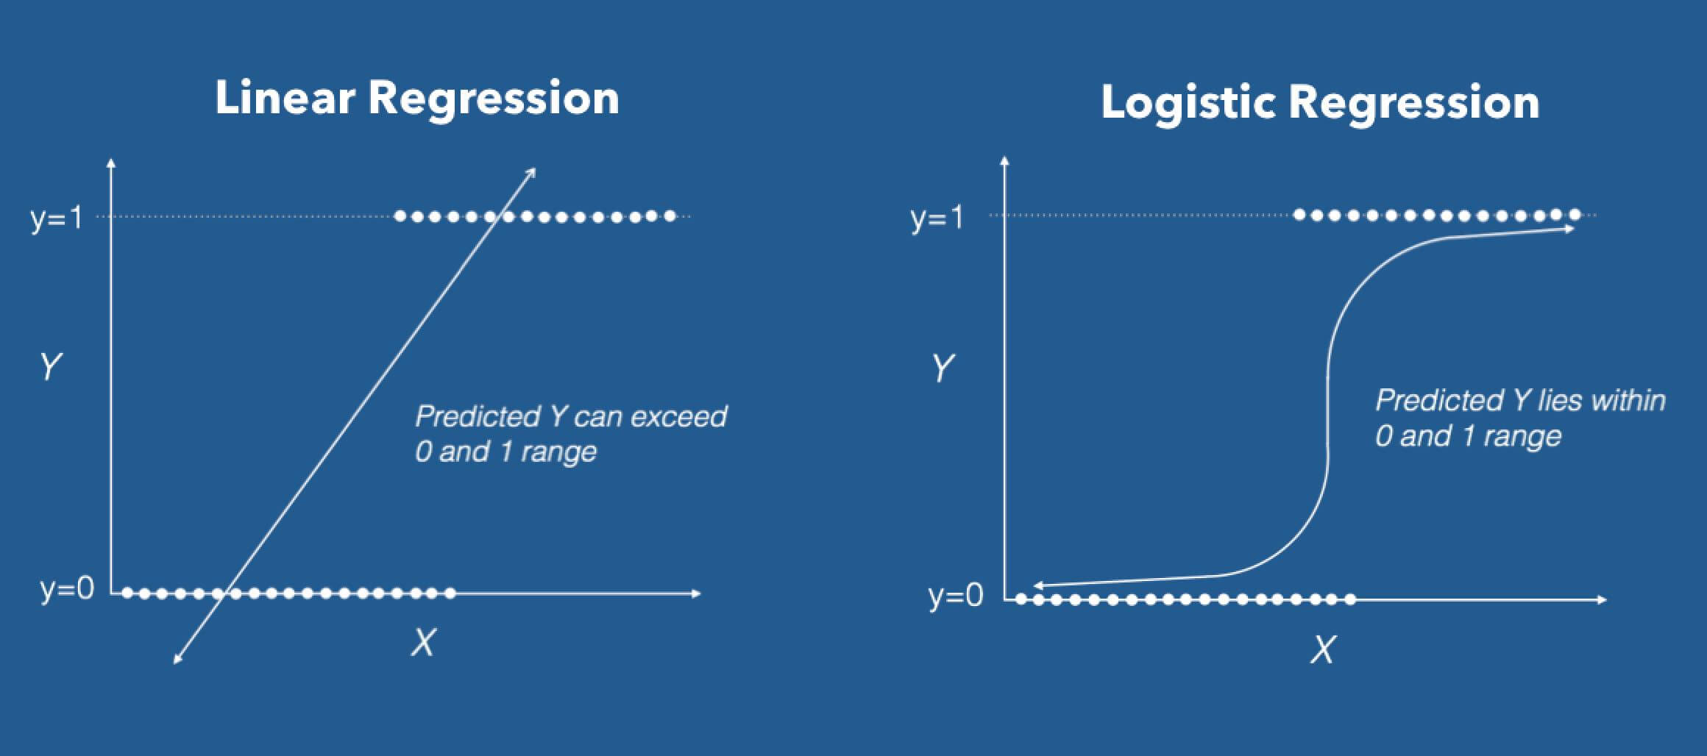
What is logistic regression?
logistic regression is a method to create classification between different object. For example, lets say we have a soccer player and a basketball player characteristics like height, speed, weight and so on. The logistical regression would try to classify any new player into soccer player or basketball player represented by one and zero.

Slide 24
Create new dataframe for the machine learning
We took the following data in order to build our machine learning model:
Year, rank, votes and duration.
We got new column that if the rating is 6.7 or above the cell in the column receives 1 else 0.

Slide 25
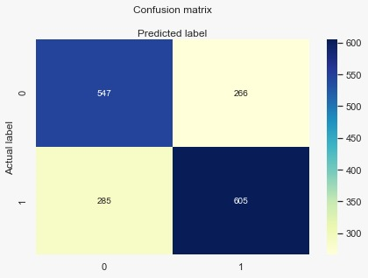
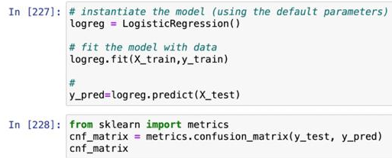
Machine learning resualts
We tried to apply the machine learning on all of our data- and machine was right about 68%)

Slide 26
Main question conclusion
We can predict movies popularity by their characteristics so if you plan to see a movie we recommend you to look at his characteristics before

